Slide 1
THE NEARLY EXTINCTION OF BEES AND FUTURE OF THE ROBOBEES
Santiago Santacruz Ramirez
Duvan Andres Ramirez
Medellín,(Date is not assing)

Slide 2
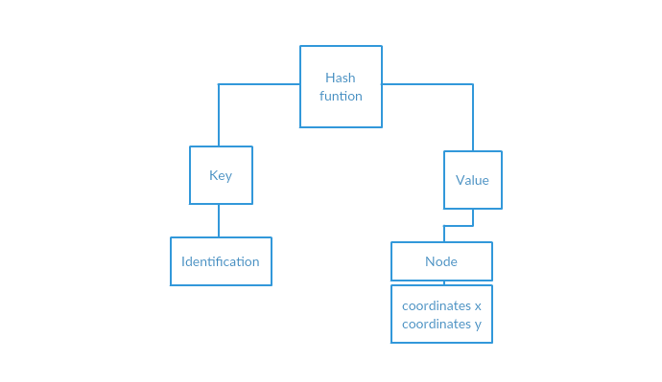
Spatial Hash with LinkedList
Figure 1: is a hash map that relates a key and the value that is a linked list of bees and have the coordinates that each bee have

Slide 3
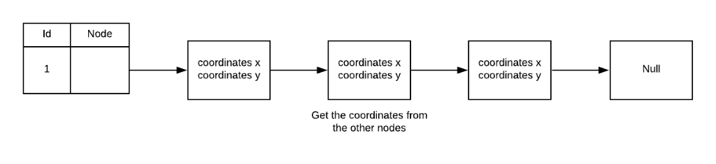
Data Structure Operations
Method | Complexity
NewBee | O(1)
Distance | O(nLong(n))
Insert | O(1)
Compare | O(nLong(n))
Figure 2: compare the bees belonging to the key that they have, the coordinates of each one are in a linked list. This method is important to calculate the distance in another method.
Figure 3: Analysis complexity

Slide 4
Design Criteria of the Data Structure
To solve the problem we focus on the search data
To search operation of the hash function in java is O(1), so it is very efficient in the comparison of very large amount of data.
There for the search of the function hash is very effective in this kind of problem

Slide 5
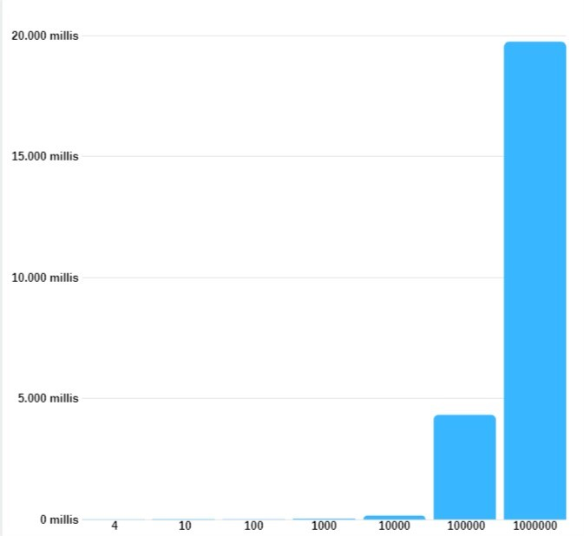
Time and Memory Consumption
In the program, while the data increases, the execution time increases. Fortunately for the one houndred data taken from each data set, the problem does not reach his worst case.

